Slide 1
160 AI& VR Thurs’s Class Activities
April 2nd

Slide 2
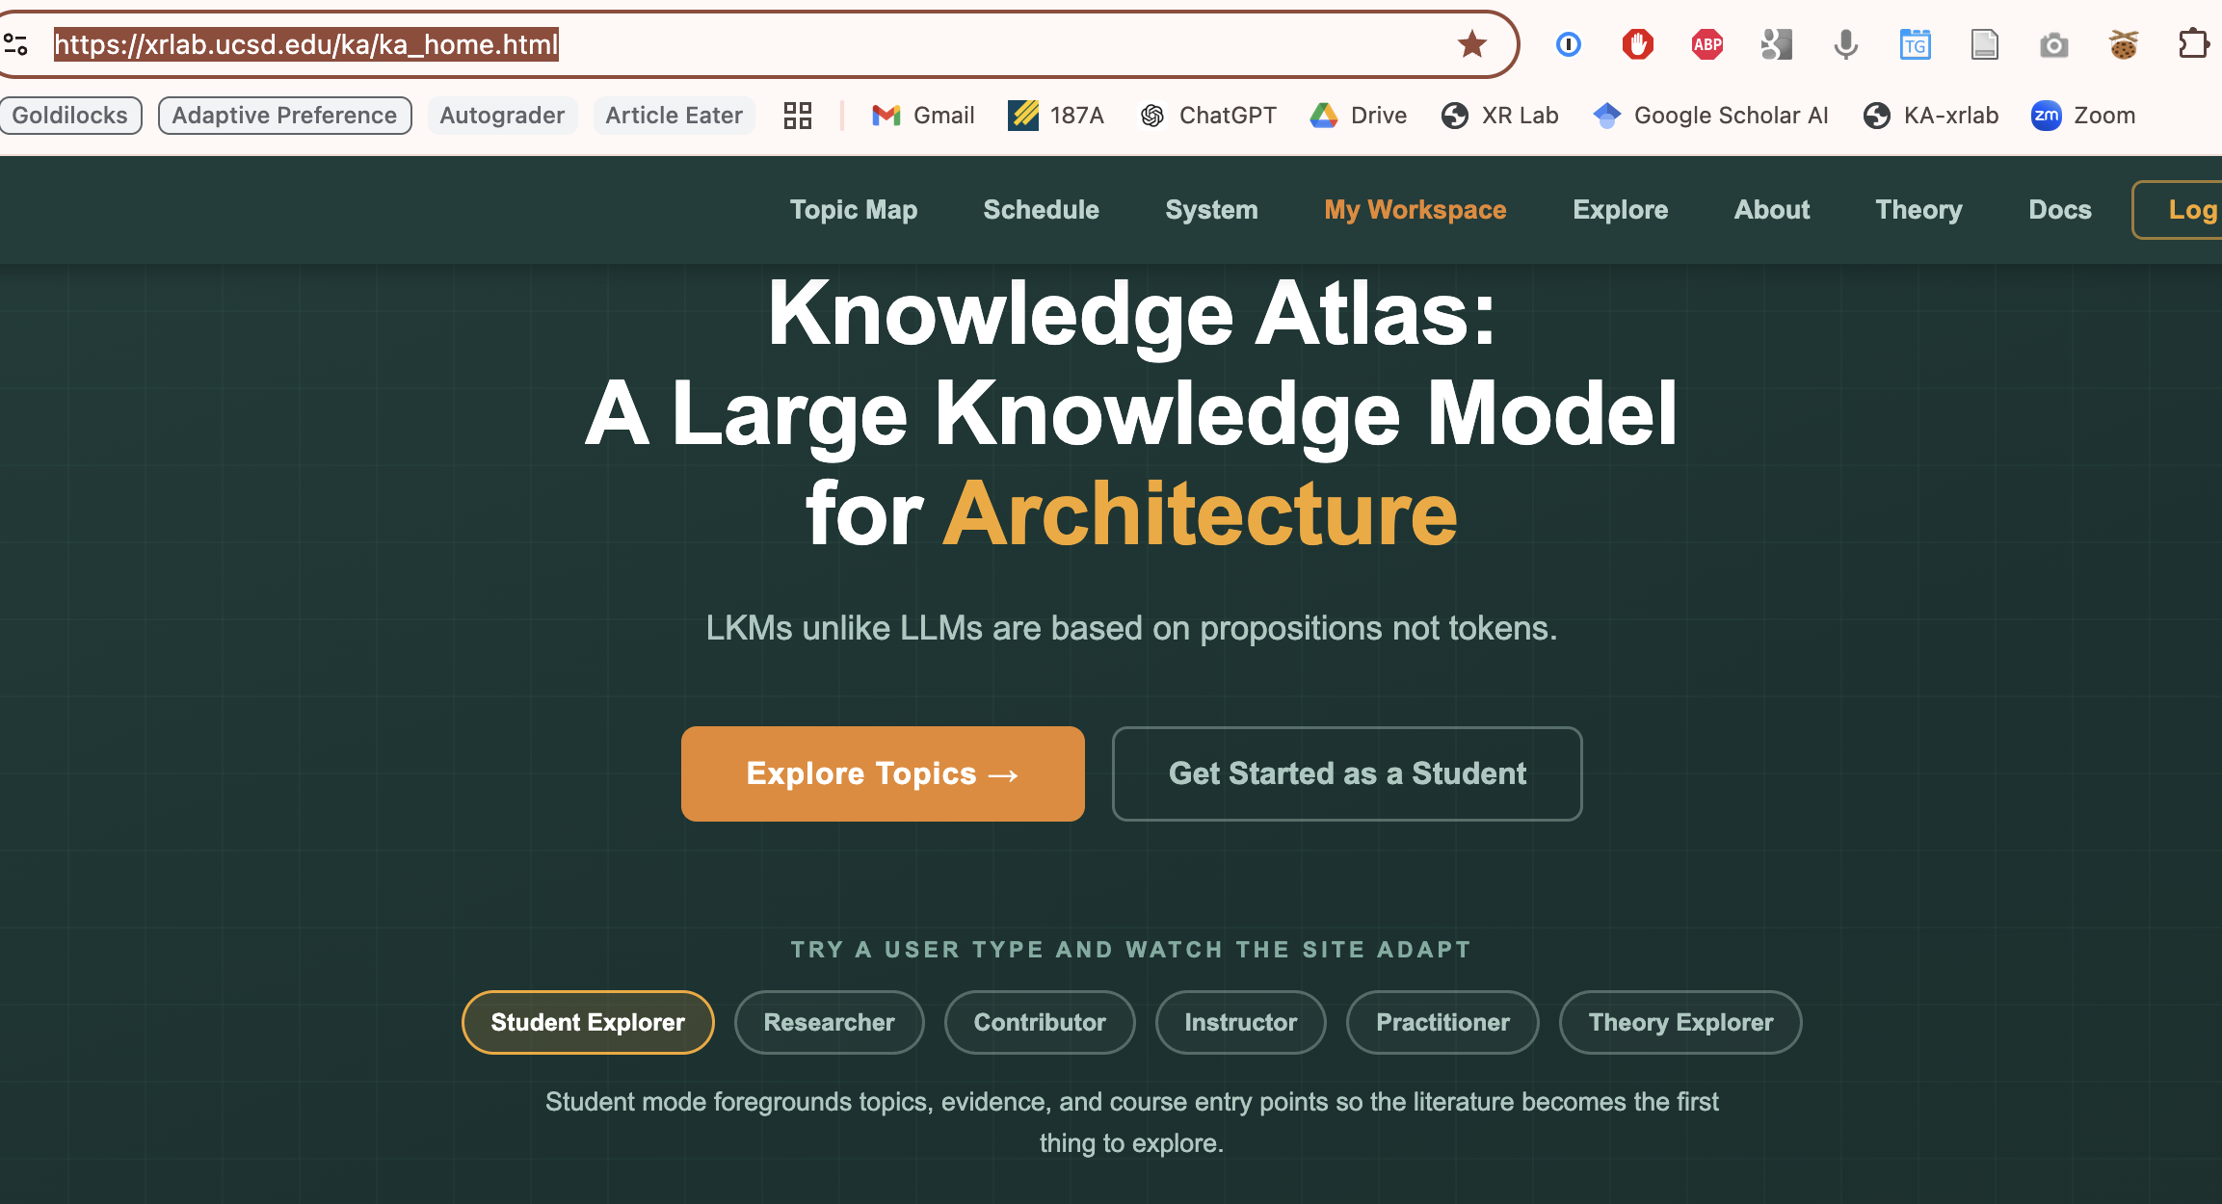

Slide 3
Getting started as a student – interaction
On clicking here if the person is not a yet logged in as a student they are taken to the login/registration page where it they fill in the registration form correctly they are automatically registered without my approval. Then when they login they are taken to the next page in this ppt. - the get started
If students login and they have already done A0 then they go to the course schedule page

Slide 4
There is an inconsistency in the navigation somewhere. Look at the pages we have and find the navigation that looks like it is for students in 160 – show it to me
I want there to be a breadcrumb for this intial student sequence
So when they land on get started the page title in the body should be in the breadcrumb position and we use that for this sequence
COGS160 start > AI Methodology > Collect Articles > The 4 Tracks
Obviously the breadcrumb sequence just written is what you see when you finally get to The 4 Tracks – they unfold in the correct manner step by step
Create the necessary connections with CTA’s if they are not already there and the breadcrumbs should be hot

Slide 5
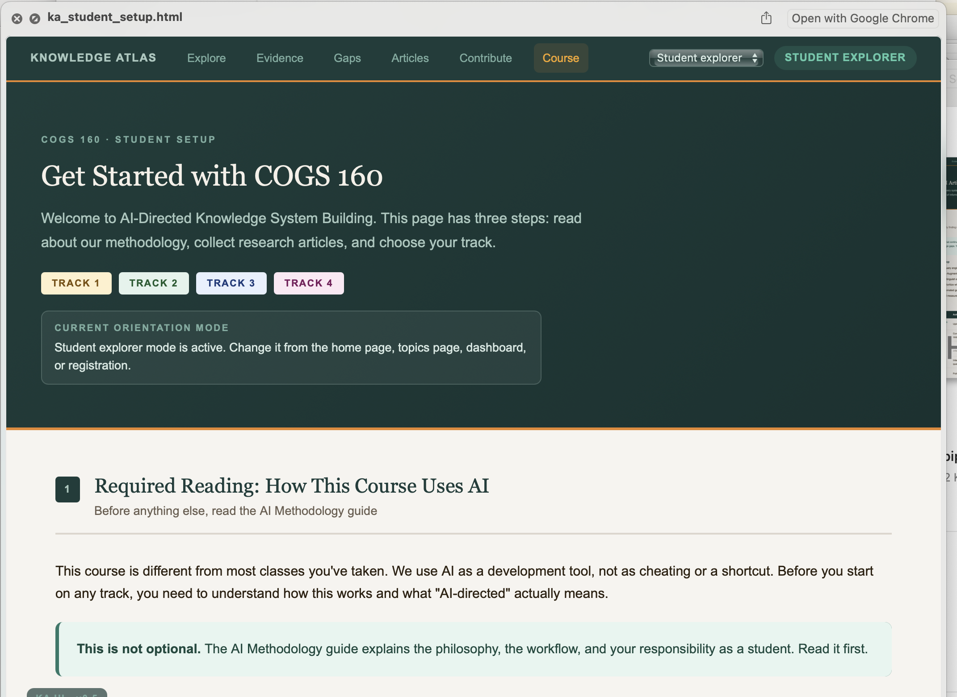
Start here

Slide 6
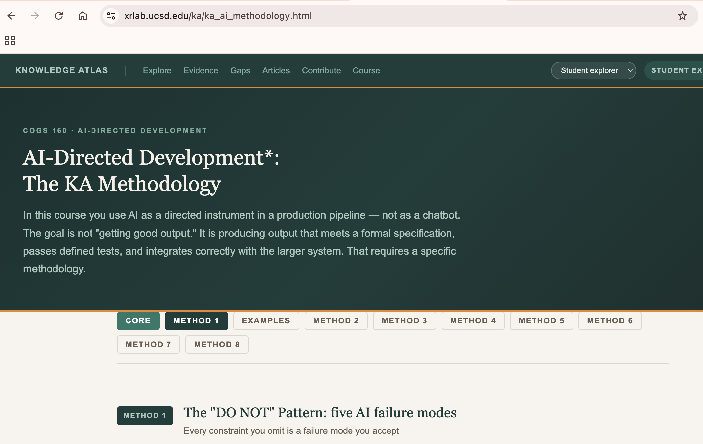

Slide 7
Add CTA to AI Methodology
Because students are sent to the AI methodology page first and they are supposed to go A0 Collect Articles second there has to be a second CTA at the bottom of each AI Methodology page that says Collect Articles Assignment

Slide 8
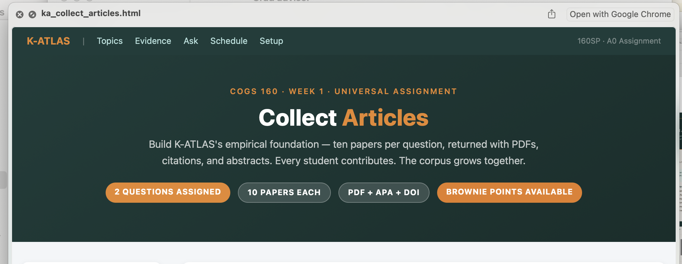

Slide 9
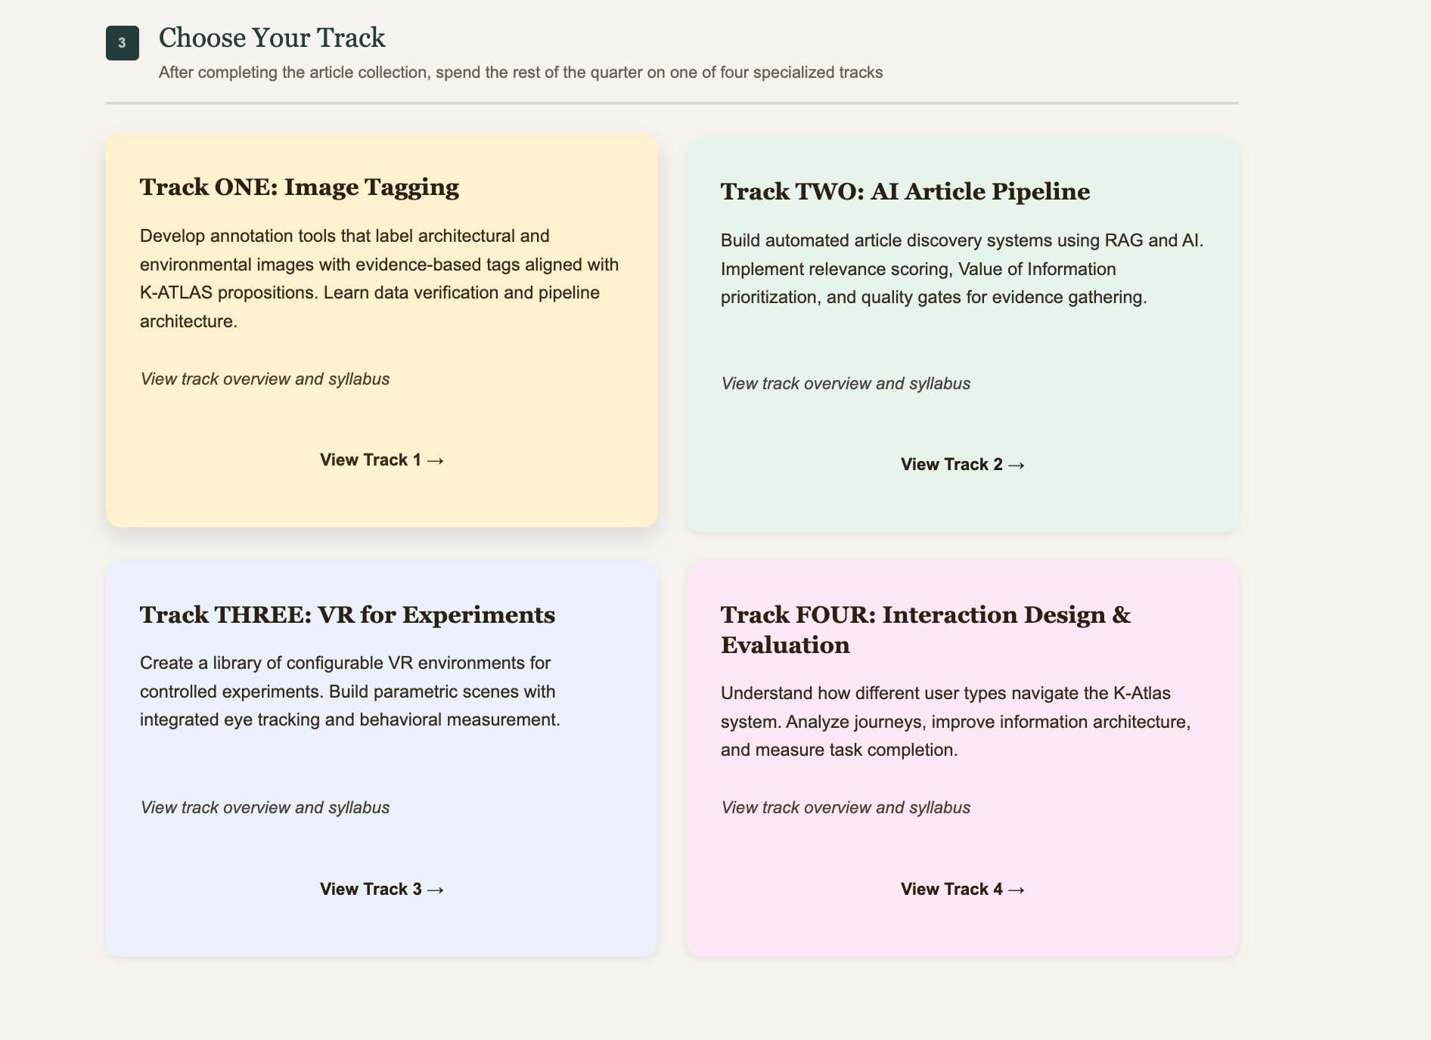
After the collect article page
The CTA to The 4 Tracks should be a new page that is made from just the item 3 Choose your Track part of the Get started page. The tracks in the cards link the same way

Slide 11
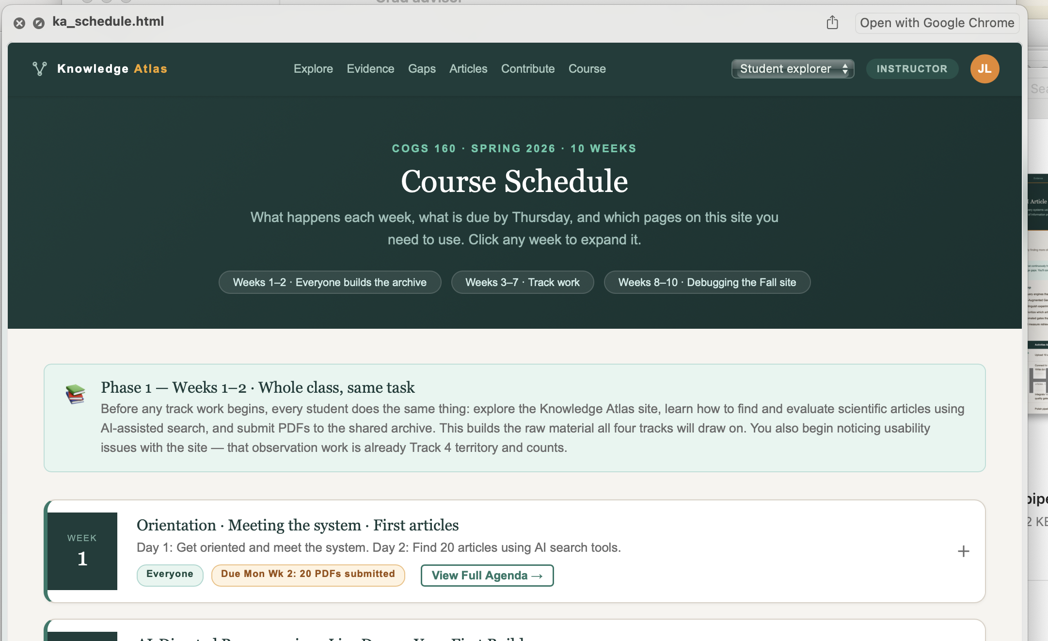
This is the course schedule page that becomes the student default

Slide 12
END – ignore next pages

Slide 15
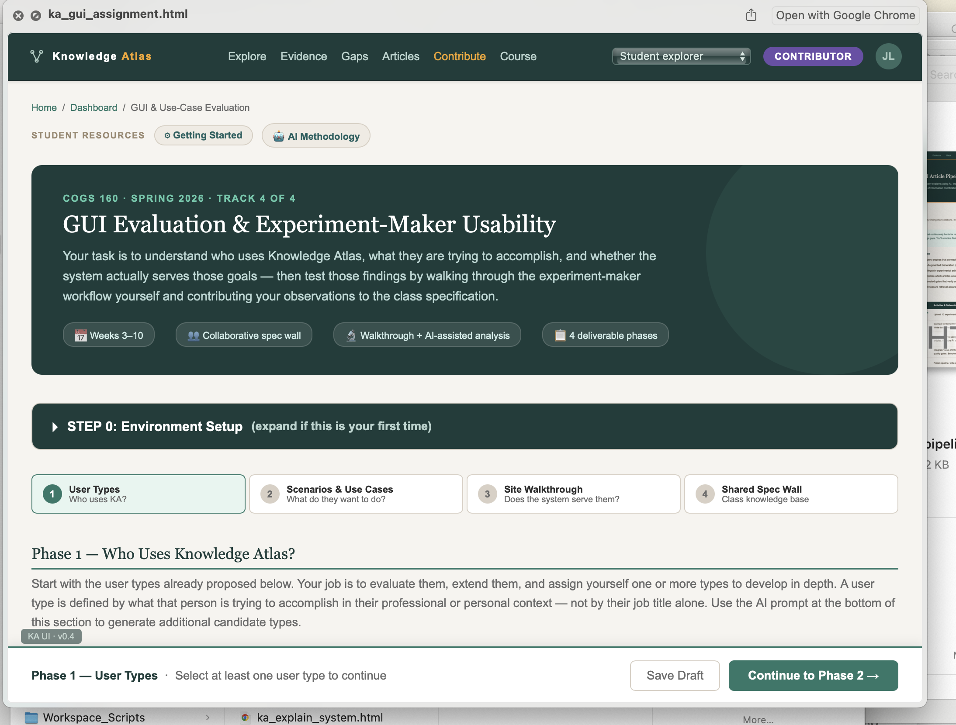
maybe

